Slide 1
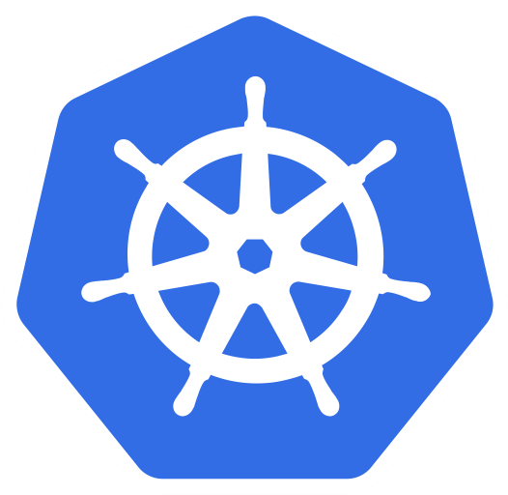



KUBERNETES
( Part 2 )
Prepared by: Aamir Pinger
fb.com/AamirPingerOfficial
linkedin.com/in/AamirPinger
github.com/AamirPinger

Slide 2
Minikube
Kubernetes architecture consist of Master node and worker nodes
Minikube is a tool that makes it easy to run Kubernetes locally
Minikube runs a single-node Kubernetes cluster on your laptop to use kubernetes for practice or development
To start Kubernetes cluster using minikube
aamir@ap-linux:~$ minikube start
😄 minikube v1.1.1 on linux (amd64)
🔥 Creating virtualbox VM (CPUs=2, Memory=2048MB, Disk=20000MB) ...
🐳 Configuring environment for Kubernetes v1.14.3 on Docker 18.09.6
🚜 Pulling images ...
🚀 Launching Kubernetes ...
⌛ Verifying: apiserver proxy etcd scheduler controller dns
🏄 Done! kubectl is now configured to use "minikube"
Source: https://kubernetes.io/docs/setup/learning-environment/minikube/

Slide 3
Minikube
To check the status of minikube
aamir@ap-linux:~$ minikube status
host: Running
kubelet: Running
apiserver: Running
kubectl: Correctly Configured: pointing to minikube-vm at 192.168.99.100
To check addresses of the kubernetes master and services
aamir@ap-linux:~$ kubectl cluster-info
Kubernetes master is running at https://192.168.99.100:8443
KubeDNS is running at https://192.168.99.100:8443/api/v1/namespaces/kube-system/services/kube-dns:dns/proxy
To further debug and diagnose cluster problems, use 'kubectl cluster-info dump'.

Slide 4
NODES

Slide 5
Nodes
Group of server is called a cluster
Kubernetes cluster is consist of master node and worker nodes
Master node act as a manager
Worker nodes are server or system on which kubernetes deploys and run our applications
To list down nodes in kubernetes cluster
aamir@ap-linux:~$ kubectl get nodes
NAME STATUS ROLES AGE VERSION
Minikube Ready master 1m v1.10.0
You also can use kubectl get no command

Slide 6
Nodes
To check the additional detail of node
aamir@ap-linux:~$ kubectl describe nodes minikube
This command show many important things related to worker node, few are
Labels
Annotations
Unschedulable
Capacity
System Info
Allocated resources
Events etc

Slide 7
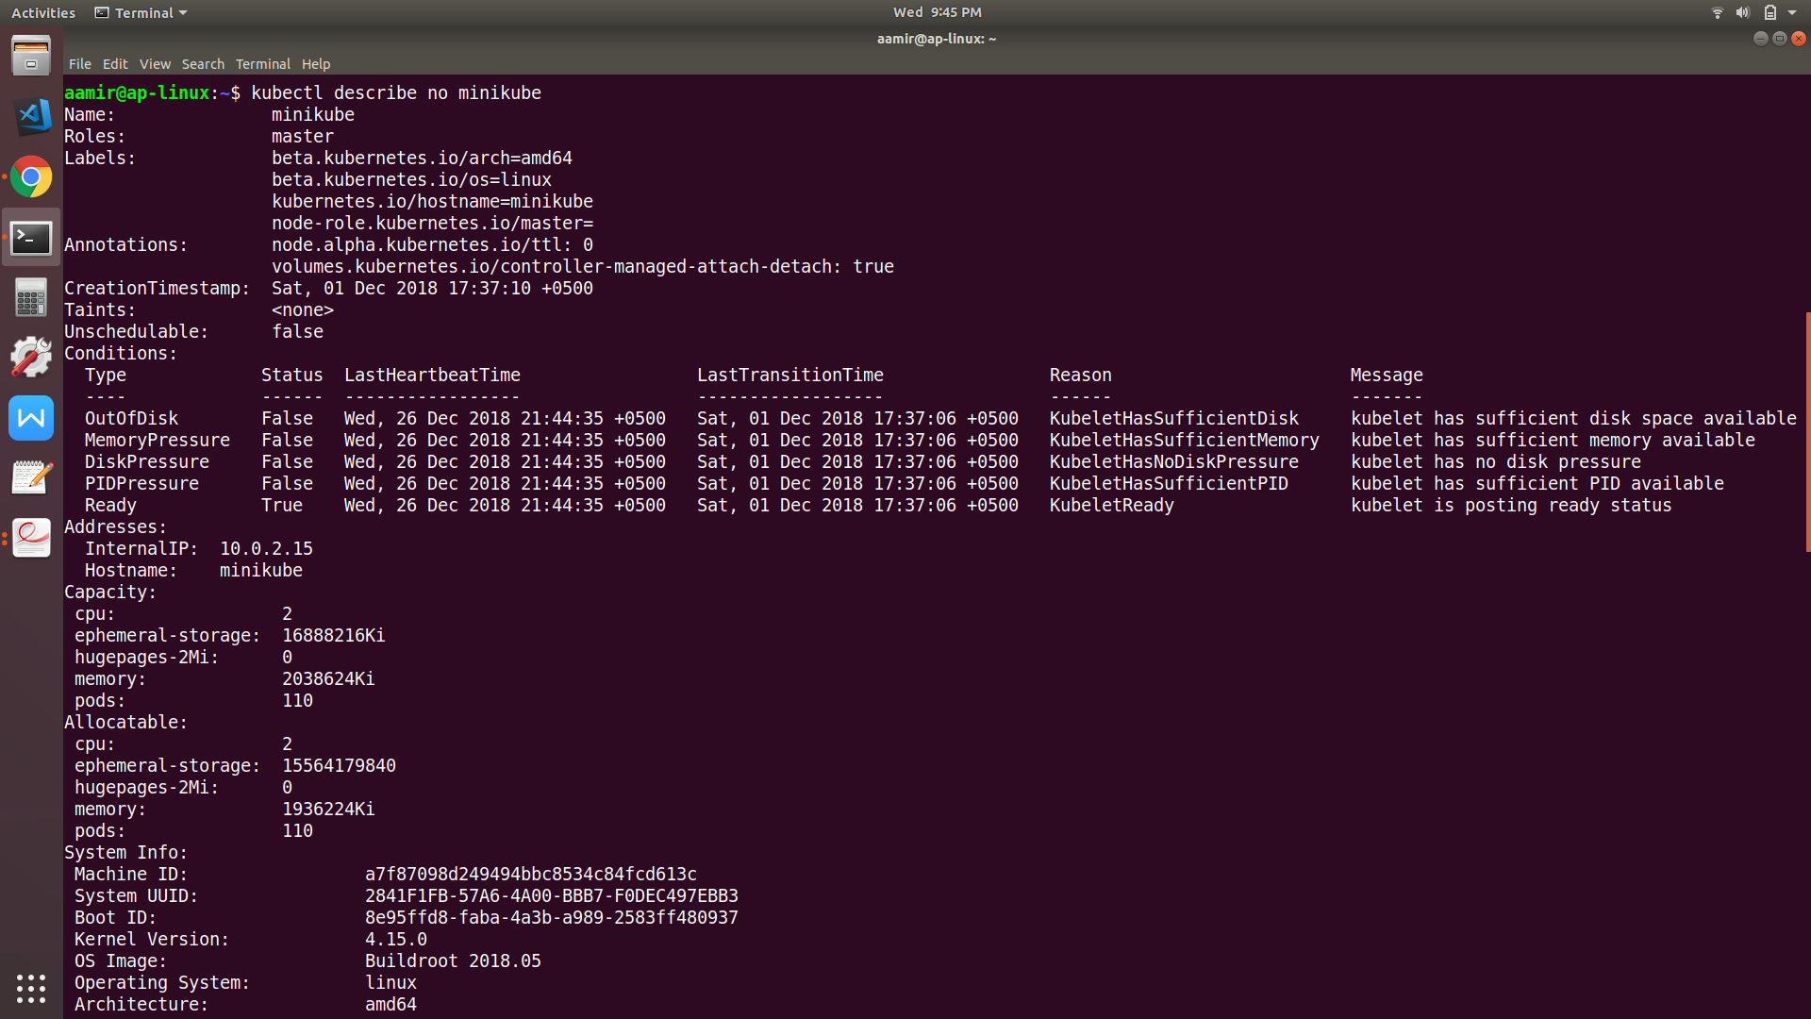

Slide 8
ALIAS

Slide 9
Alias
As you will go further you will see you will be typing kubernetes long command again and again
We can use Linux alias command to make the long commands shorter. For example
aamir@ap-linux:~$ alias kg=”kubectl get”
aamir@ap-linux:~$ kg nodes
NAME STATUS ROLES AGE VERSION
Minikube Ready master 1m v1.14.3
aamir@ap-linux:~$ kg no
NAME STATUS ROLES AGE VERSION
Minikube Ready master 1m v1.14.3

Slide 10
PODS

Slide 11
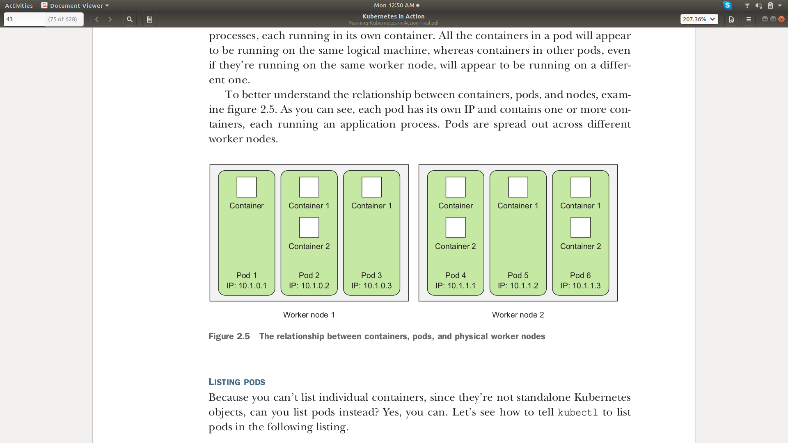
Pods
To run your application on kubernetes most basic condition is your application should be containerized
But Kubernetes do not deploy your app’s container directly like docker does
Instead, kubernetes wraps our app container or group of containers together
This container wrapper is called a Pod

Slide 12
Pods
Each pod is like a separate logical machine with its own IP, hostname, processes, and so on, running a single application

Slide 13
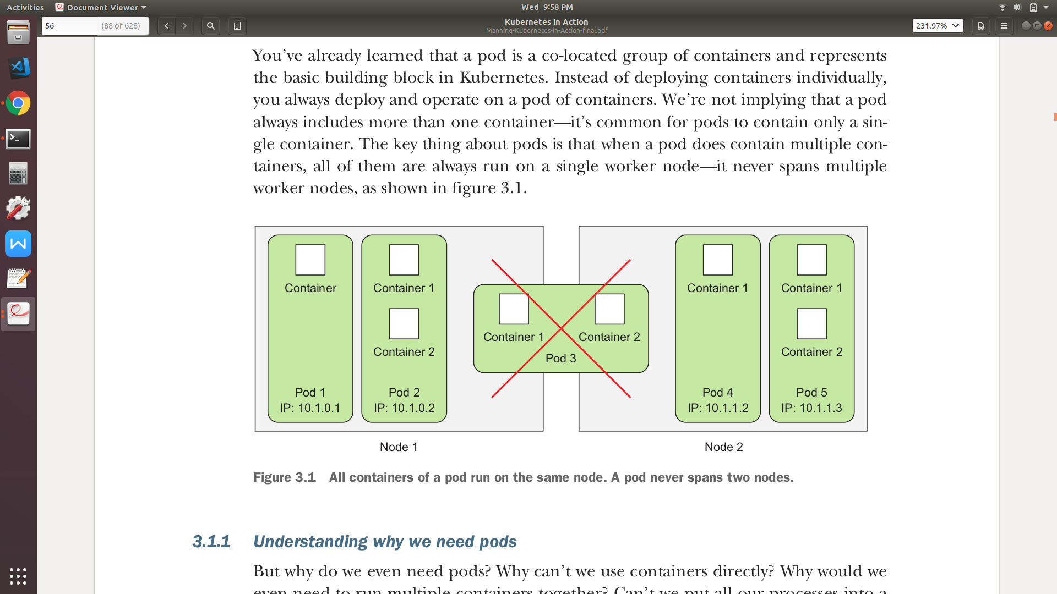
Pods
All the containers in a pod will appear to be running on the same logical machine
A Pods with multiple container will always run on a same worker node

Slide 14
WHY PODS?

Slide 15
?
Why do we even need pods?
Why can’t we use containers directly?
As we’re not supposed to group multiple processes into a single container
We will be needing another higher-level construct that will allow you to bind containers together and manage them as a single unit

Slide 16
Why would we even need to run multiple containers together?
?
You may have a supporting container with your main application container
For example a log collection, network proxy etc

Slide 17
Can’t we put all our processes into a single container?
?
Yes we can do that, but we don’t
We try to divide our application in smaller microservices
This makes our app’s smaller in size fast to load

Slide 18
Pods
A pod of containers allows you to run closely related processes together
Kubernetes provide these containers with (almost) the same environment as if they were all running in a single container, while keeping them somewhat isolated
“Somewhat isolated”, this is because you want containers inside each group to share certain resources, although not all, so that they’re not fully isolated
For example if your main application’s container write logs in some file and you want another application to use some part of that log file and make some report

Slide 19
Pods
Thanks to kubernetes which provides volume concept by which we can share files directories between containers with in the pods
This is also one of the reason why pods having multiple container does not spread over different nodes. They always co-located on same worker node

Slide 20
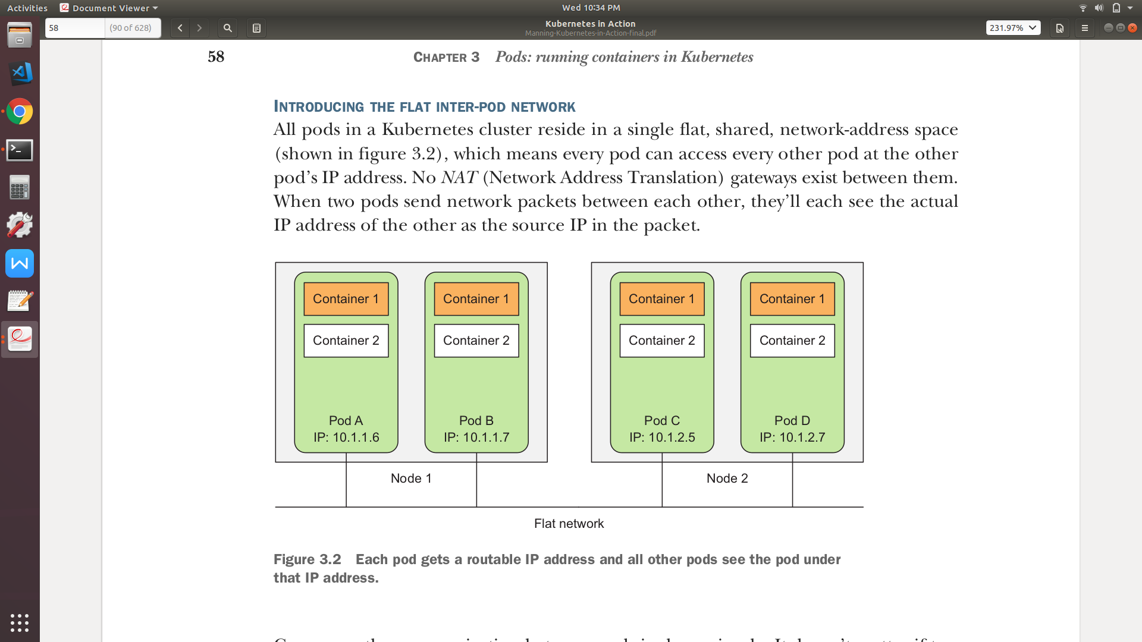
Pods
Same like dockers, in kubernetes all containers in a Pod also uses same IP but different port numbers
Port conflicts if same port number allocated only concerns containers in the same pod
Containers of different pods can never run into port conflicts, because each pod has a separate port space

Slide 21
SHOULD WE RUN MULTI-TIER APPS INTO SINGLE PODS
?

Slide 22
Pods
Yes you can BUT it’s not the right way
For example: If you have a two-node Kubernetes cluster and we have learned multiple container in a single pod always runs on a single worker node
Disadvantages
A single worker node will be utilize
Not taking advantage of the computational resources (CPU and memory)
You have at your disposal on the second node

Slide 23
When to put two containers on single pod?
?

Slide 24
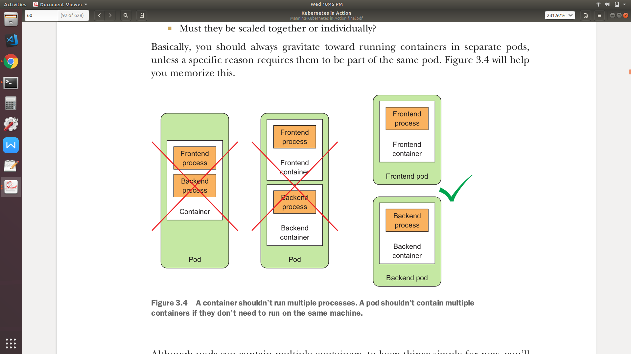
Pods
When deciding you always need to ask yourself the following questions:
Do they need to be run together or can they run on different hosts?
Do they represent a single whole or are they independent components?
Must they be scaled together or individually?

Slide 25
LET’S CREATE A POD

Slide 26
POD Definition
Sample structure in YAML
kind: <Resource Type>
apiVersion: <Kubernete API Version>
metadata:
name: <Resource name>
spec:
containers:
- name: <Container name>
image: <Container Image>
status:
containerStatuses:
...
podIP: <Pod IP>
To define a POD one way is to define POD configuration in YAML file or JSON format
YAML ("YAML Ain't Markup Language") is commonly used for human-readable configuration files
JSON (JavaScript Object Notation) is a lightweight data-interchange format
Kuberenet official documentation recommends to write your configuration files using YAML rather than JSON as YAML tends to be more user-friendly

Slide 27
POD Definition
Kubernetes API version resource belongs to
Type of resource
Pod
Deployments
Jobs
Others
Metadata includes the
Name
Namespace
Labels
Other information about the pod

Slide 28
POD Definition
Spec contains the actual description of the pod’s contents, such as
Pod’s containers
Volumes
Security Context
Other data
Status contains the current information about the running pod, such as
Pod’s Condition
Every container’s description and status
Pod’s internal IP and other basic info

Slide 29
Creating Pods with YAML
kind: Pod
apiVersion: v1
metadata:
name: myfirstpod
spec:
containers:
- name: container1
image: aamirpinger/helloworld
ports:
- containerPort: 80
aamir@ap-linux:$ kubectl create -f myfirstpod.yaml Pod “myfirstpod” created

Slide 30
POD Listing

Slide 31
Pod Listing
aamir@ap-linux:$ kubectl get pods Pod “myfirstpod” created
NAME READY STATUS RESTARTS AGE
myfirstpod 1/1 Running 0 15m
You can even write kubectl get po

Slide 32
YAML FROM POD

Slide 33
YAML FROM POD
We created pod with YAML, What if we have already a pod and we wanted to check pod insights
aamir@ap-linux:$ kubectl get pod myfirstpod -o yaml apiVersion: v1
kind: Pod
metadata:
creationTimestamp: "2019-07-04T06:36:20Z"
name: myfirstpod
namespace: default
resourceVersion: "1994"
selfLink: /api/v1/namespaces/default/pods/myfirstpod
uid: 08b74341-9e26-11e9-b5e1-080027713168
spec:
containers:
- image: aamirpinger/helloworld
...

Slide 34
POD CREATION WITHOUT YAML

Slide 35
Pod Creation Without Yaml
To create a pod without writing YAML file we can use
Kubectl run <pod_name> --image=<image_name> --port=<container_exposed_port> --restart=Never
aamir@ap-linux:$ kubectl run mysecondpod --image=aamirpinger/helloworld --port=80 --restart=Never
pod/mysecondpod created
aamir@ap-linux:$ kubectl get pods
NAME READY STATUS RESTARTS AGE
myfirstpod 1/1 Running 0 70m
mysecondpod 0/1 ContainerCreating 0 4s

Slide 36
PORT FORWARDING

Slide 37
Port Forwarding
Our pod is created which got our helloworld application but still not accessible at browser
kubectl port-forward <pod_name> <external_port>:<container_port>
aamir@ap-linux:$ kubectl port-forward mysecondpod 6500:80
Forwarding from 127.0.0.1:6500 -> 80
Forwarding from [::1]:6500 -> 80
http://localhost:6500

Slide 38
LABELS

Slide 39
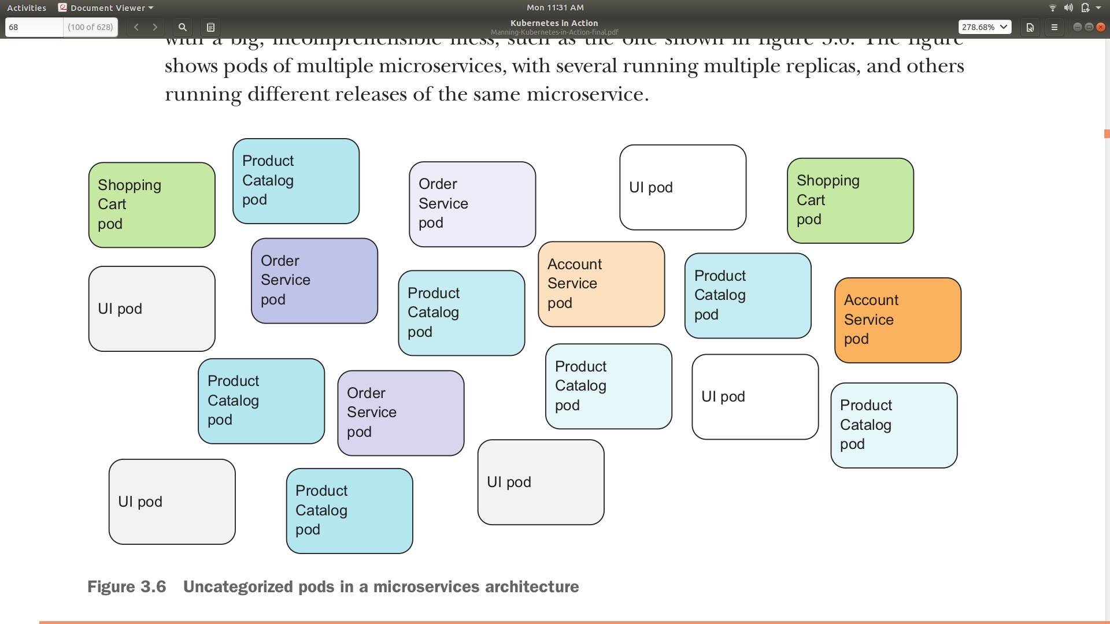
Labels
Uptil now we have successfully create a pod having one container
Theoretically, we have learnt that kubernetes does help creating n^{th} number of replicas
Theoretically, we have also learnt that kubernetes can groups pods providing at a single static IP address
Think of situation where you have hundreds of pods with multiple replicas

Slide 40
Question arises
?
What mechanism kubernetes use for organizing them?

Slide 41
Question arises
?
How group of pods can be managed with a single action instead of having to perform the action for each pod individually

Slide 42
Labels
Kubernetes organizes pods with the help of labels
Labels are simple key/value pair that kubernetes uses with almost all the resources it creates to group them
Kubernetes gives option to filter the resources by providing label criteria
Multiple labels can be assigned to any resource and they become part of resource group having with same labels
Labels can be assigned at a time of resource creation or even you can assign or change label value after creation of the resource

Slide 43
Creating Pods With Labels
kind: Pod
apiVersion: v1
metadata:
name: myfirstpodwithlabel
labels:
type: backend
env: production
spec:
containers:
- name: container1
image: aamirpinger/helloworld
ports:
- containerPort: 80
aamir@ap-linux:$ kubectl create -f myfirstpodwithlabel.yaml Pod “myfirstpodwithlabel” created

Slide 44
Creating Pods With Labels
To create a pod without writing YAML file we can use
Kubectl run <pod_name> --image=<image_name> --port=<container_exposed_port> --restart=Never --labels=key1=val1,key2=val2…,keyN=valN
aamir@ap-linux:$ kubectl run anotherpodwithlabel --image=aamirpinger/helloworld --port 80 --restart=Never --labels=type=frontend,env=develop
pod/anotherpodwithlabel created

Slide 45
PODS LISTING WITH LABELS

Slide 46
Pods Listing With Labels
To get the labels in the listing
aamir@ap-linux:$ kubectl get po --show-labels
NAME READY STATUS RESTARTS AGE LABELS
myfirstpod 1/1 Running 0 70m <none>
anotherpodwithlabel 0/1 Running 0 4s env=develop,type=frontend
...
To make label as a column
aamir@ap-linux:$ kubectl get po -L env,type
NAME READY STATUS RESTARTS AGE ENV TYPE
myfirstpod 1/1 Running 0 70m
myfirstpodwithlabel 1/1 Running 0 7m8s production
anotherpodwithlabel 0/1 Running 0 4s develop frontend
...

Slide 47
PODS LABELS AT RUNTIME

Slide 48
Pods Listing With Labels
Assigning labels to existing pods
aamir@ap-linux:$ kubectl label pod myfirstpod app=helloworld type=frontend
aamir@ap-linux:$ kubectl get po --show-labels
NAME READY STATUS RESTARTS AGE LABELS
myfirstpod 1/1 Running 0 70m app=helloworld,type=frontend
anotherpodwithlabel 1/1 Running 0 4s env=develop,type=frontend
...
Modifying existing labels of existing pods
aamir@ap-linux:$ kubectl label pod anotherpodwithlabel env=prod --overwrite
aamir@ap-linux:$ kubectl get po --show-labels
NAME READY STATUS RESTARTS AGE LABELS
myfirstpod 1/1 Running 0 71m app=helloworld,type=frontend
anotherpodwithlabel 1/1 Running 0 1m env=prod,type=frontend
...

Slide 49
PODS LISTING WITH LABEL SELECTOR

Slide 50
Pods Listing With Label Selector
Label selector can be used as criteria for filtering any resources
We can use label as criteria to check if
Contains (or doesn’t contain) a label with a certain key
Contains a label with a certain key and value
Contains a label with a certain key, but with a value not equal to the one you specify
Contains (or doesn’t contain) any one of supplied value in any particular label key

Slide 51
Pods Listing With Labels
Contains a label with a certain key/value
aamir@ap-linux:$ kubectl get po -l type=frontend
NAME READY STATUS RESTARTS AGE
myfirstpod 1/1 Running 0 3h59m
anotherpodwithlabel 1/1 Running 0 36m
...
aamir@ap-linux:$ kubectl get po -l type=frontend --show-labels
NAME READY STATUS RESTARTS AGE LABELS
myfirstpod 1/1 Running 0 4h1m app=helloworld,type=frontend
anotherpodwithlabel 1/1 Running 0 38m env=develop,type=frontend
...

Slide 52
Pods Listing With Labels
Contains a multiple labels with a certain key/value
aamir@ap-linux:$ kubectl get po -l env=prod,type=frontend --show-labels
NAME READY STATUS RESTARTS AGE LABELS
anotherpodwithlabel 1/1 Running 0 53m env=prod,type=frontend
Does NOT contains a label value against certain key
aamir@ap-linux:$ kubectl get po -l type!=frontend --show-labels
NAME READY STATUS RESTARTS AGE LABELS
myfirstpodwithlabel 1/1 Running 0 37m type=backend,env=production
mysecondpod 1/1 Running 0 138m run=mysecondpod
...

Slide 53
Pods Listing With Labels
Does contains a label irrespective of the value
aamir@ap-linux:$ kubectl get po -l type --show-labels
NAME READY STATUS RESTARTS AGE LABELS
myfirstpod 1/1 Running 0 4h10m app=helloworld,type=frontend
anotherpodwithlabel 1/1 Running 0 47m env=prod,type=frontend
...
Does NOT contains a label irrespective of the value
aamir@ap-linux:$ kubectl get po -l ‘!type’ --show-labels
NAME READY STATUS RESTARTS AGE LABELS
mysecondpod 1/1 Running 0 138m run=mysecondpod

Slide 54
Pods Listing With Labels
Contains any value from provided list of values against any key
aamir@ap-linux:$ kubectl get po -l 'type in (backend,frontend)' --show-labels
NAME READY STATUS RESTARTS AGE LABELS
myfirstpod 1/1 Running 0 4h29m app=helloworld,type=frontend
myfirstpodwithlabel 1/1 Running 0 62m env=production,type=backend
anotherpodwithlabel 1/1 Running 0 53m env=prod,type=frontend
Does NOT contains any value from provided list of values against any key
aamir@ap-linux:$ kubectl get po -l 'type notin(backend,frontend)' --show-labels
NAME READY STATUS RESTARTS AGE LABELS
mysecondpod 1/1 Running 0 165m run=mysecondpod

Slide 55
PODS SCHEDULING WITH NODE SELECTOR

Slide 56
Pods Scheduling With Node Selector
kind: Pod
apiVersion: v1
metadata:
name: podwithnodeselector
spec:
nodeSelector:
disk_type: ”ssd”
containers:
- name: container1
image: aamirpinger/helloworld
ports:
- containerPort: 80
This will deploy this new pod on a worker node where label is disk_type=ssd

Slide 57
ANNOTATION

Slide 58
Annotation
Kubernetes also provide annotation feature with labels
Annotation are basically words that explanation or comment on something
For example, annotation can be used to write creator’s name or contact or about application it running
Labels are meant to hold limited information whereas you can have larger annotation with any resource
Annotation are way to add some extra information to the resource but it cannot be used to group or filter like labels

Slide 59
Pod Creation With Annotation
kind: Pod
apiVersion: v1
metadata:
name: podwithannotation
annotations:
createdBy: Aamir Pinger
email: aamirpinger@yahoo.com
spec:
containers:
- name: container1
image: aamirpinger/helloworld
ports:
- containerPort: 80
aamir@ap-linux:$ kubectl create -f podwithannotation.yaml Pod “podwithannotation” created

Slide 60
Annotation Assignment To Any Resource
To annotate any existing resource
aamir@ap-linux:$ kubectl annotate pod myfirstpod createdBy="Aamir Pinger" email="aamirpinger@yahoo.com"
pod/myfirstpod annotated
Let’s check by re generating YAML from pod
aamir@ap-linux:$ kubectl get pod myfirstpod -o yaml email="aamirpinger@yahoo.com"
apiVersion: v1
kind: Pod
metadata:
annotations:
createdBy: Aamir Pinger
email: aamirpinger@yahoo.com

Slide 61
DESCRIBING POD’S INSIGHTS

Slide 62
DESCRIBING POD’S INSIGHTS
We can have any resource insight with kubectl describe command
aamir@ap-linux:$ kubectl describe pod myfirstpod
Name: myfirstpod
Namespace: default
Priority: 0
PriorityClassName: <none>
Node: minikube/10.0.2.15
Start Time: Thu, 04 Jul 2019 11:36:20 +0500
Labels: app=helloworld
type=frontend
Annotations: createdBy: Aamir Pinger
email: aamirpinger@yahoo.com
Status: Running
IP: 172.17.0.7
Containers:
container1:
...

Slide 63
NAMESPACE

Slide 64
Namespace
With labels we have seen how easy is to group resources
But what if any label overlaps, for example
type=frontend is assigned to few pods with app_name=web and env=development
type=frontend is assigned to few pods with app_name=web and env=production
Name of particular resource will always be unique, what about setting the similar environment as production when in development, QA phase
But what about times when you want to split objects into separate, non-overlapping groups? You may want to only operate inside one group at a time

Slide 65
Namespace
For this and other reasons, Kubernetes also groups objects into namespaces
Namespace is a kind of virtualbox which isolate self contain resources with other namespace
You can easily separate the scope of resources using namespaces. E.g. Resource in namespace for development phase cannot harm resources in namespace for production
Similarly you can split them into multiple namespaces, which also allows you to use the same resource names multiple times (across different namespaces)

Slide 66
Namespace
To create a namespace
aamir@ap-linux:$ kubectl create namespace production
namespace/production created
Kubectl create ns production can also be used
To get a list of namespaces
aamir@ap-linux:$ kubectl get namespace
NAME STATUS AGE
default Active 37h
kube-node-lease Active 37h
kube-public Active 37h
kube-system Active 37h
production Active 51s

Slide 67
Namespace
To create a pod in any particular namespace
aamir@ap-linux:$ kubectl run myfirstpod --image aamirpinger/helloworld --restart=Never --namespace=production
pod/myfirstpod created
To get any resource from any particular namespace
aamir@ap-linux:$ kubectl get pod --namespace production
NAME READY STATUS RESTARTS AGE
myfirstpod 1/1 Running 0 4m45s
To get any resource from all namespaces
aamir@ap-linux:$ kubectl get pod --all-namespace
NAMESPACE NAME READY STATUS RESTARTS AGE
default myfirstpod 1/1 Running 0 36h ...

Slide 68
DELETING A RESOURCE

Slide 69
DELETING A RESOURCE
Kubectl delete <resource_type> <resource_name> --namespace=<optional_namespace_name>
To delete pod from default namespace
aamir@ap-linux:$ kubectl delete pod myfirstpod
Pod “myfirstpod” deleted
To delete pod from from any particular namespace
aamir@ap-linux:$ kubectl delete pod myfirstpod --namespace production
Pod “myfirstpod” deleted

Slide 70
DELETING A RESOURCE
To delete pod based on label criteria
aamir@ap-linux:$ kubectl delete pod -l kubectl delete pod -l 'type in(frontend,backend)'
pod "anotherpodwithlabel" deleted
pod "myfirstpodwithlabel" deleted
To delete all pods
aamir@ap-linux:$ kubectl delete pod --all
pod "anotherpodwithlabel" deleted
pod "myfirstpodwithlabel" deleted
To delete pod from from any particular namespace
aamir@ap-linux:$ kubectl delete ns production
namespace "production" deleted

Slide 71
ReplicaSets

Slide 72
ReplicaSets
ReplicaSet is also one of the resource in kubernetes like pods and others are
ReplicaSet is the resource that help creating and managing multiple copies of application (replicas) in kubernetes
When we create any pod through ReplicaSet It ensures its pods are always kept running
If the pod disappears for any reason, such as
If the worker node disappears from the cluster
If the pod was evicted from the worker node
The ReplicaSet notices the missing pod and creates a replacement pod

Slide 73
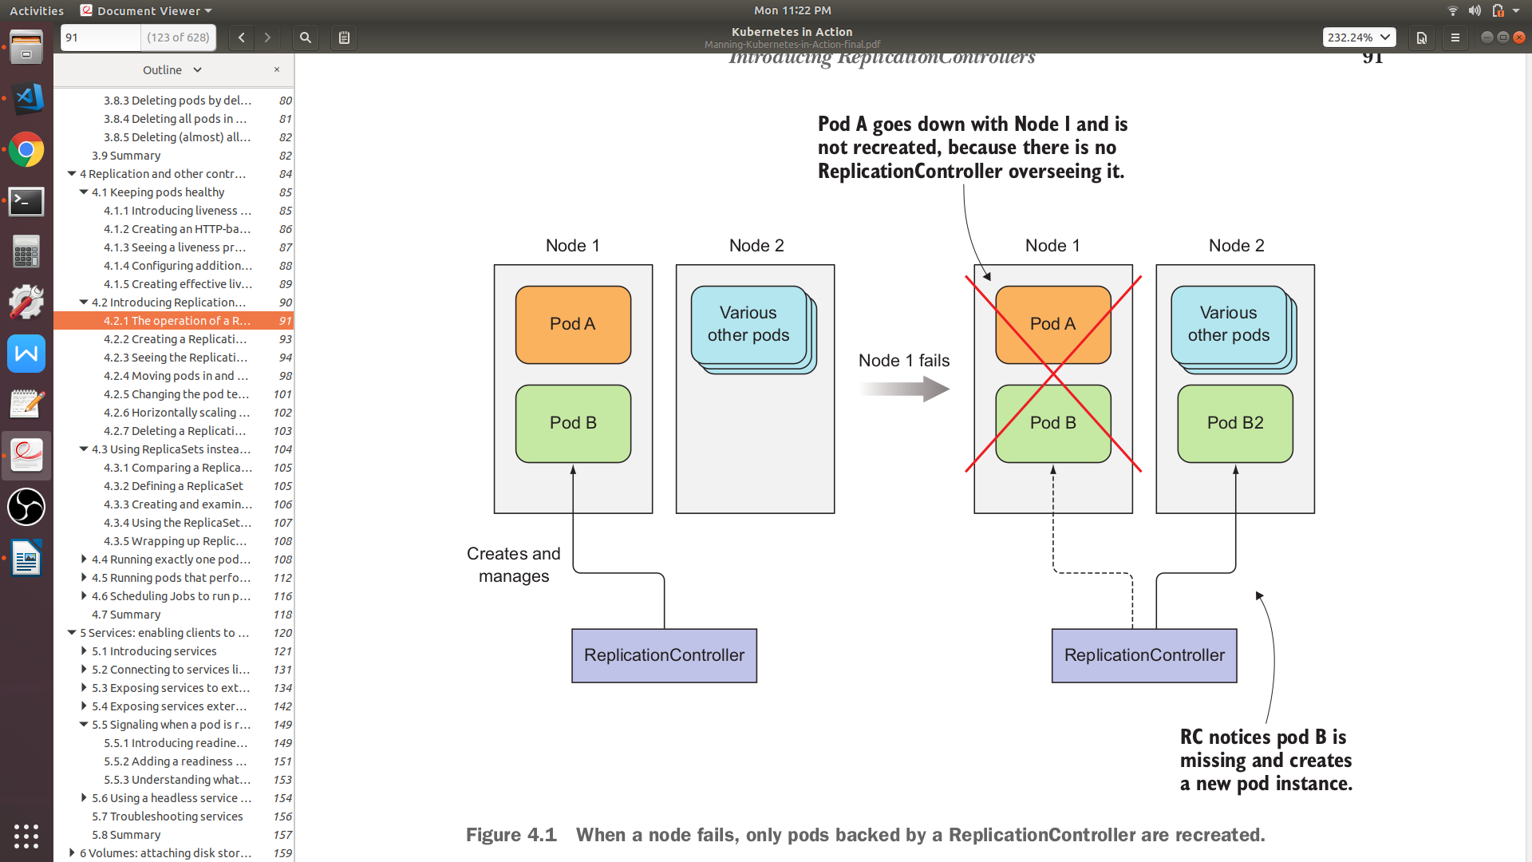
ReplicaSets
Pod A goes down with Node 1 and not recreated, because it was not created with ReplicaSets
ReplicaSets
ReplicaSets
Pod B is recreate on Node 2 because ReplicaSet make sure its Pod are kept runnig

Slide 74
ReplicaSets
A ReplicaSet has three essential parts
Label selector
Determines what pods are in the ReplicaSet scope
Replica count
Specifies the desired number of pods that should be running
Pod template
ReplicaSet uses to create new pod

Slide 75
ReplicaSets
replicaset.yaml
apiVersion: apps/v1beta2
kind: ReplicaSet
metadata:
name: my-replica-set
spec:
replicas: 3
selector:
matchLabels:
app: myapp
template:
metadata:
labels:
app: myapp
metadata:
...
spec:
containers:
- name: my-rs-container
image: aamirpinger/flag:latest
ports:
- containerPort: 80
These two must match, otherwise infinite number of pod will be created
aamir@ap-linux:~$ kubectl create -f replicaset.yaml
replicaset.apps/my-replica-set created

Slide 76
ReplicaSets
To get the list of ReplicaSets resource
aamir@ap-linux:~$ kubectl get replicasets
NAME DESIRED CURRENT READY AGE
my-replica-set 3 3 3 5m6s
Kubectl get rs can also be used
To get the list of ReplicaSets resource
aamir@ap-linux:~$ kubectl get pod
NAME READY STATUS RESTARTS AGE
my-replica-set-m644t 1/1 Running 0 8m55s
my-replica-set-4m4kt 1/1 Running 0 8m55s
my-replica-set-njndl 1/1 Running 0 8m55s
....

Slide 77
ReplicaSets
Let’s manually delete one pod and check what effect it gets on pods listing
aamir@ap-linux:~$ kubectl delete pod my-replica-set-m644t
pod "my-replica-set-m644t" deleted
Let’s get the list of ReplicaSet and pods together
aamir@ap-linux:~$ kubectl get rs,pod
NAME READY STATUS RESTARTS AGE
pod/my-replica-set-4m4kt 1/1 Running 0 8m55s
pod/my-replica-set-njndl 1/1 Running 0 8m55s
pod/my-replica-set-snhjt 0/1 ContainerCreating 0 3s
....
NAME DESIRED CURRENT READY AGE
replicaset.extensions/my-replica-set 3 3 2 13m

Slide 78
ReplicaSets
Let’s manually delete one pod and check what effect it gets on pods listing
aamir@ap-linux:~$ kubectl describe rs my-replica-set
Name: my-replica-set
Namespace: default
Selector: app=myapp
Labels: <none>
Annotations: <none>
Replicas: 3 current / 3 desired
Pods Status: 3 Running / 0 Waiting / 0 Succeeded / 0 Failed
Pod Template:
Labels: app=myapp
Containers:
my-rs-container:
Image: aamirpinger/flag:latest
...

Slide 79
ReplicaSets
Let’s make a Pod out of scope of ReplicaSets by changing label of any pod
aamir@ap-linux:~$ kubectl label pod my-replica-set-njndl app=myappNEW --overwrite
pod/my-replica-set-njndl labeled
Let’s get the list of ReplicaSet and pods together
aamir@ap-linux:~$ kubectl get rs,pod --show-labels
NAME READY STATUS RESTARTS AGE LABELS
pod/my-replica-set-4m4kt 1/1 Running 0 18m app=myapp
pod/my-replica-set-8xtwv 0/1 ContainerCreating 0 4s app=myapp
pod/my-replica-set-njndl 1/1 Running 0 18m app=myappNEW
pod/my-replica-set-snhjt 1/1 Running 0 13m app=myapp
....
NAME DESIRED CURRENT READY AGE LABELS
replicaset.extensions/my-replica-set 3 3 2 13m <none>

Slide 80
ReplicaSets
To edit any resource you can also use
kubectl edit <resource type> <resource name>
Let’s make the lable again app=myapp of pod my-replica-set-njndl
aamir@ap-linux:~$ kubectl edit pod my-replica-set-njndl
pod/my-replica-set-njndl edited
aamir@ap-linux:~$ kubectl get rs,pod --show-labels
NAME READY STATUS RESTARTS AGE LABELS
pod/my-replica-set-4m4kt 1/1 Running 0 26m app=myapp
pod/my-replica-set-8xtwv 0/1 Terminating 0 10m app=myapp
pod/my-replica-set-njndl 1/1 Running 0 26m app=myapp
pod/my-replica-set-snhjt 1/1 Running 0 20m app=myapp
....
NAME DESIRED CURRENT READY AGE LABELS
replicaset.extensions/my-replica-set 3 3 3 26m <none>

Slide 81
ReplicaSets
We used matchLabels in selector of ReplicaSet configuration in which we can add multiple labels
Based on those labels ReplicaSet will look for pods that have all those labels together and group them
In ReplicaSet you can even add additional expressions to the selector
...
metadata:
name: my-replica-set
spec:
replicas: 3
selector:
matchExpressions:
- key: app
operator: In
values:
- myapp
template:
metadata:
labels:
...

Slide 82
ReplicaSets
There are 4 operators for matchExpressions
In,
notIn,
Exists,
DoesNotExist
It’s important to remember that If you specify both matchLabels and matchExpressions then all the labels must match to group the resource

Slide 83
ReplicaSets
All of the three parts of ReplicaSet can be modified at runtime
Only changes to the replica count will affect existing pods
Changes to label selector and pod template in ReplicaSet will only affect new containers
Due to change in label selector or pod label itself, If existing pods fall out of the scope of the ReplicaSet, so the controller stops caring about them

Slide 84
POD SCALING

Slide 85
Pod Scaling
ReplicaSets make sure a desired number of pod instances is always running
Scaling number of pods up and down can be done anytime
If you will scale up, ReplicaSet will add more pod
If you will scale down, ReplicaSet will terminate pods to match the numbers
aamir@ap-linux:~$ kubectl scale rs my-replica-set --replicas=5
replicaset.extensions/my-replica-set scaled
aamir@ap-linux:~$ kubectl get rs
NAME DESIRED CURRENT READY AGE
replicaset.extensions/my-replica-set 5 5 5 4h17m
aamir@ap-linux:~$ kubectl scale rs my-replica-set --replicas=2
replicaset.extensions/my-replica-set scaled

Slide 86
Pod Scaling
Even if you delete or add a pod manually with the same labels used by replicaSets to group the pods, it will automatically add or terminate pods to match the exact numbers provided to replicaSets
When you delete a replicaSet all the pods under that replicaSet will also get terminated
Kubernetes does provide --cascade=false option for deleting only replicaSet and not the pods under it
aamir@ap-linux:~$ kubectl delete rs my-replica-set --cascade=false
replicaset.extensions "my-replica-set" deleted

Slide 87
JOB

Slide 88
Job
Job is another resource in kubernetes
It’s basically a Pod which we create under the type (kind) of Job
A job resource is used to create a pod which terminates automatically when the defined job of that pods successfully completed
A job resource creates one or more pods and ensures that a specified number of them successfully terminate

Slide 89
Job
The Job object will start a new Pod if the first pod fails or is deleted (for example due to a node hardware failure or a node reboot)
A Job can also be used to run multiple pods in parallel
Deleting a Job resource will cleanup the pods it created

Slide 90
Job
apiVersion: batch/v1
kind: Job
metadata:
name: whalesay
spec:
template:
spec:
containers:
- name: whalesay
image: docker/whalesay
command: ["cowsay", "This is a Kubernetes Job!"]
restartPolicy: Never
backoffLimit: 4
activeDeadlineSeconds: 60
restartPolicy: Never or OnFailure is allowed
OnFailure - the Pod stays on the node, but the Container get a restart
Never - the Job controller starts a new Pod and leave the unsuccessful pod as it is
Source 1: https://kubernetes.io/docs/concepts/workloads/controllers/jobs-run-to-completion/
Source 2: https://eksworkshop.com/batch/jobs/

Slide 91
Job
apiVersion: batch/v1
kind: Job
metadata:
name: whalesay
spec:
template:
spec:
containers:
- name: whalesay
image: docker/whalesay
command: ["cowsay", "This is a Kubernetes Job!"]
restartPolicy: Never
backoffLimit: 4
activeDeadlineSeconds: 60
backoffLimit
Specify the number of retries before considering a Job as failed
6 is default retries set back-off limit by kubernetes
Failed Pods associated with the Job are recreated by the Job controller with an exponential back-off delay (10s, 20s, 40s …) capped at six minutes
Source 1: https://kubernetes.io/docs/concepts/workloads/controllers/jobs-run-to-completion/
Source 2: https://eksworkshop.com/batch/jobs/

Slide 92
Job
apiVersion: batch/v1
kind: Job
metadata:
name: whalesay
spec:
template:
spec:
containers:
- name: whalesay
image: docker/whalesay
command: ["cowsay", "This is a Kubernetes Job!"]
restartPolicy: Never
backoffLimit: 4
activeDeadlineSeconds: 60
activeDeadlineSeconds
Applies to the duration of the job
Once a Job reaches activeDeadlineSeconds, all of its Pods are terminated and the Job status will become type: Failed with reason: DeadlineExceeded
Source 1: https://kubernetes.io/docs/concepts/workloads/controllers/jobs-run-to-completion/
Source 2: https://eksworkshop.com/batch/jobs/

Slide 93
Job
aamir@ap-linux:~$ kubectl create -f job.yaml
job.batch/whalesay created
aamir@ap-linux:~$ kubectl get po,job
NAME READY STATUS RESTARTS AGE
pod/whalesay-qqsh7 0/1 Completed 0 10s
...
NAME COMPLETIONS DURATION AGE
job.batch/whalesay 1/1 6s 10s
aamir@ap-linux:~$ kubectl describe job whalesay
Name: whalesay
...
Active Deadline Seconds: 60s
Pods Statuses: 0 Running / 1 Succeeded / 0 Failed
Pod Template:
...

Slide 94
Job
aamir@ap-linux:~$ kubectl logs whalesay-qqsh7
___________________________
< This is a Kubernetes Job! >
---------------------------
\
\
\
## .
## ## ## ==
## ## ## ## ===
/""""""""""""""""___/ ===
~~~ {~~ ~~~~ ~~~ ~~~~ ~~ ~ / ===- ~~~
\______ o __/
\ \ __/
\____\______/

Slide 95
CRONJOB

Slide 96
CronJob
This works almost similar to Kubernetes Job resource
Only difference is Job resource create Pod instantly and once job is completed it does not recreate Job resource or pod
CronJob resource is used to schedule Job at later time and can be set to initiate the Job again on provided time gap
CronJob always creates only a single Job resource for each execution configured in the schedule

Slide 97
CronJob
apiVersion: batch/v1beta1
kind: CronJob
metadata:
name: batch-job-every-minute
spec:
schedule: "* * * * *"
jobTemplate:
spec:
template:
metadata:
labels:
app: periodic-batch-job
spec:
restartPolicy: OnFailure
containers:
- name: main
image: docker/whalesay
command: ["cowsay", "This is a CronJob!"]
aamir@ap-linux:~$ kubectl create -f cronjob.yaml
cronjob.batch/batch-job-every-minute created

Slide 98
CronJob
aamir@ap-linux:~$ kubectl create -f cronjob.yaml
cronjob.batch/batch-job-every-minute created
aamir@ap-linux:~$ kubectl get po,cj
NAME READY STATUS RESTARTS AGE
pod/batch-job-every-minute-1562696940-fznlm 0/1 Completed 0 30s
...
NAME SCHEDULE SUSPEND ACTIVE LAST SCHEDULE AGE
cronjob.batch/batch-job-every-minute * * * * * False 0 38s 50s
aamir@ap-linux:~$ kubectl describe cj batch-job-every-minute
Name: batch-job-every-minute
Namespace: default
Labels: <none>
Annotations: <none>
Schedule: * * * * *
Concurrency Policy: Allow
...

Slide 99
CronJob
aamir@ap-linux:~$ kubectl logs batch-job-every-minute-1562697180-fz59v
___________________________
< This is a Kubernetes CronJob! >
---------------------------
\
\
\
## .
## ## ## ==
## ## ## ## ===
/""""""""""""""""___/ ===
~~~ {~~ ~~~~ ~~~ ~~~~ ~~ ~ / ===- ~~~
\______ o __/
\ \ __/
\____\______/
aamir@ap-linux:~$ kubectl delete cj batch-job-every-minute
cronjob.batch/batch-job-every-minute created

Slide 100
CronJob
Schedule pattern
Examples:
Every Minute
* * * * *
Everyday 5am and 5pm
0 5,17 * * *
Every midnight in weekdays
0 0 * * 1-5
Every 15 minutes
*/15 * * * *
Every hour of alternate days
0 * */2 * *
* * * * *
Day of week (1 to 7, 1 is Monday)
Month of year (1 to 12)
Day of month (1 to 31)
Hour (0 to 23)
Minutes (0 to 59)

Slide 101
Thank you and God bless you all!
fb.com/AamirPingerOfficial
linkedin.com/in/AamirPinger
github.com/AamirPinger

